Slide 1
ATAI
Advanced Techniqueof Artificial Intelligence
ATAI
ChongqingUniversity _{AdvancedTechniqueof}
of Technology Artificial Intelligence
Chongqing University of
Technology
Chongqing University ^{ATAI}
_{of Technology} Advanced Techniqueof
Artificial Intelligence
Chongqing University of Technology
Chongqing University of Technology
RecDiff:Diffusion Model for Social Recommendation
Code: :https://github.com/HKUDS/RecDiff
2024.12.1 •ChongQing
—— CIKM_2024
Reported by Shiyan Wu
1

Slide 2
ATAI
AdvancedTechniqueof
Artificial Intelligence
ATAI
ChongqingUniversity _{AdvancedTechniqueof}
of Technology Artificial Intelligence
ChongqingUniversity of Technology
Motivation
Existing social recommendation systems are prone to noise from irrelevant social connections, and traditional self-supervised methods are limited in handling diverse social noise. To address these challenges, the author proposes a new diffusion-based approach.

Slide 3
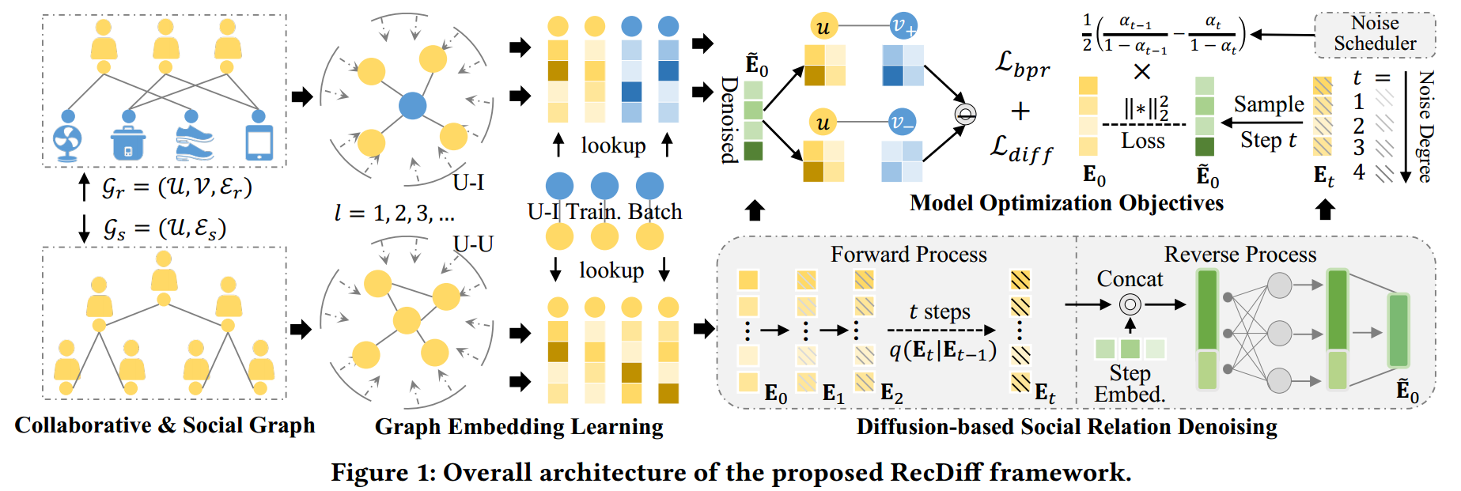
ChongqingUniversity of Technology
ATAI
AdvancedTechniqueof
Artificial Intelligence
ATAI
ChongqingUniversity _{AdvancedTechniqueof}
of Technology Artificial Intelligence
Overview

Slide 4
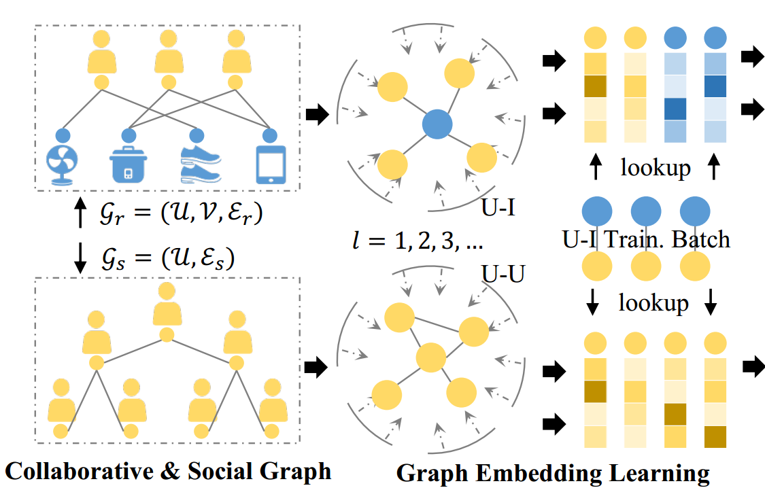
ChongqingUniversity of Technology
ATAI
AdvancedTechniqueof
Artificial Intelligence
ATAI
ChongqingUniversity _{AdvancedTechniqueof}
of Technology Artificial Intelligence
Method
(1)
(2)

Slide 5
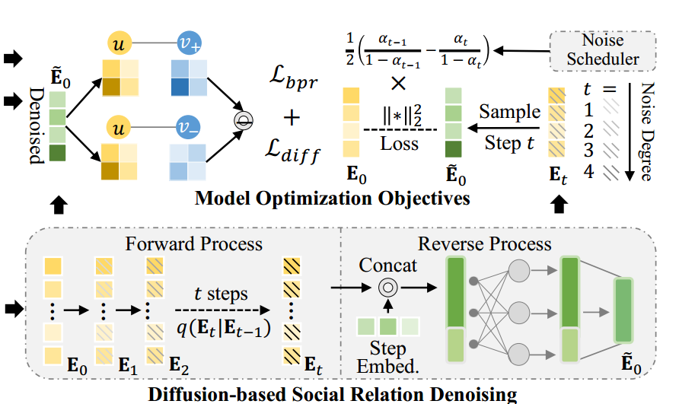
ChongqingUniversity of Technology
ATAI
AdvancedTechniqueof
Artificial Intelligence
ATAI
ChongqingUniversity _{AdvancedTechniqueof}
of Technology Artificial Intelligence
Method
(3)

Slide 6
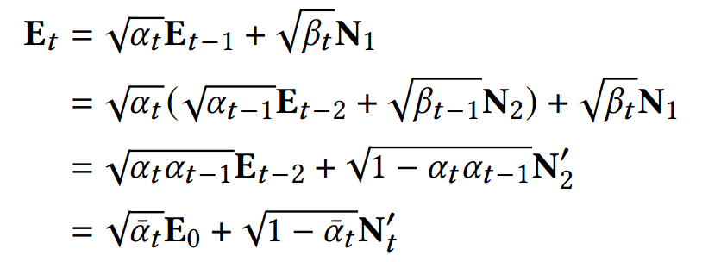
ChongqingUniversity of Technology
ATAI
AdvancedTechniqueof
Artificial Intelligence
ATAI
ChongqingUniversity _{AdvancedTechniqueof}
of Technology Artificial Intelligence
Method
(4)
(5)
(6)

Slide 7
ChongqingUniversity of Technology
ATAI
AdvancedTechniqueof
Artificial Intelligence
ATAI
ChongqingUniversity _{AdvancedTechniqueof}
of Technology Artificial Intelligence
Method
(7)
(8)

Slide 8
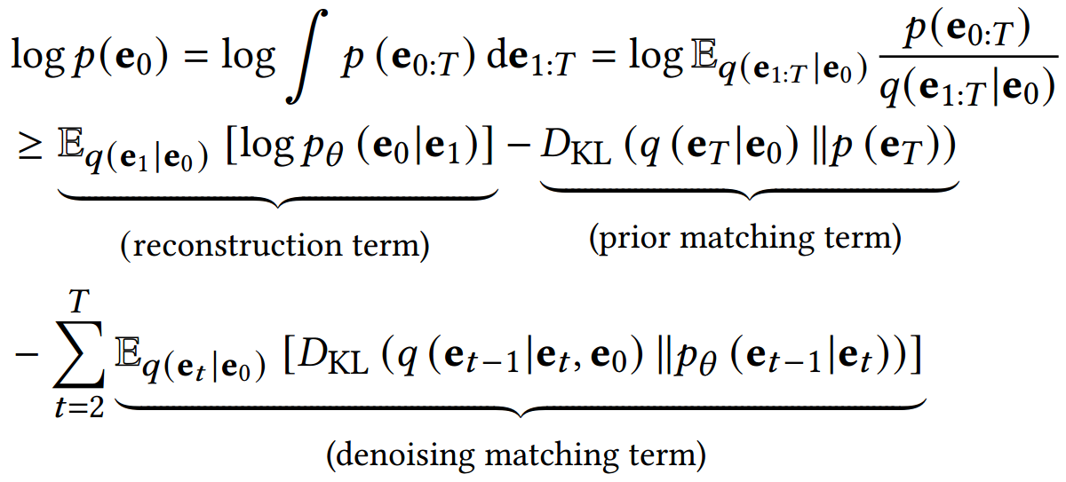
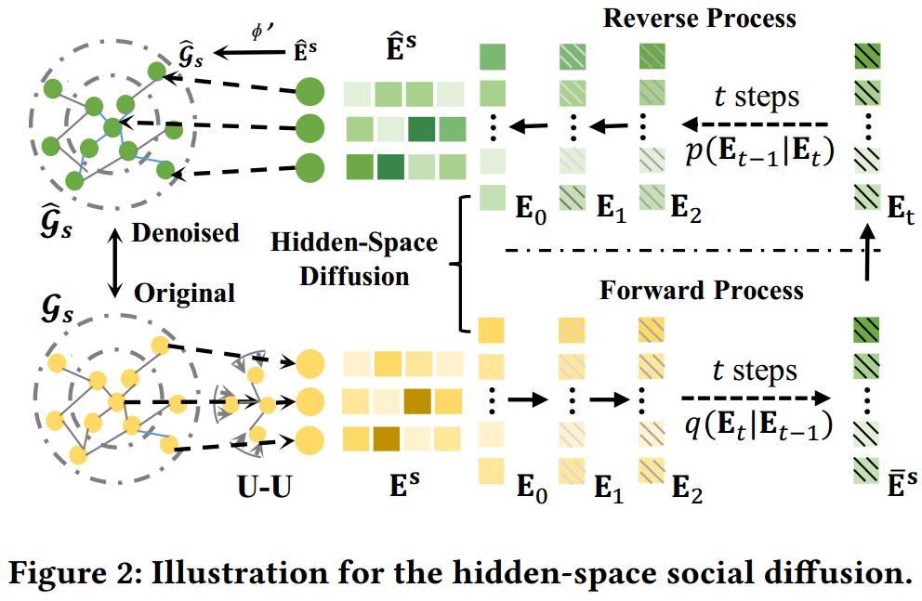
ChongqingUniversity of Technology
ATAI
AdvancedTechniqueof
Artificial Intelligence
ATAI
ChongqingUniversity _{AdvancedTechniqueof}
of Technology Artificial Intelligence
Method
(9)
(10)
(11)
(12)
(13)

Slide 9
ChongqingUniversity of Technology
ATAI
AdvancedTechniqueof
Artificial Intelligence
ATAI
ChongqingUniversity _{AdvancedTechniqueof}
of Technology Artificial Intelligence
Method
(14)
(15)

Slide 10
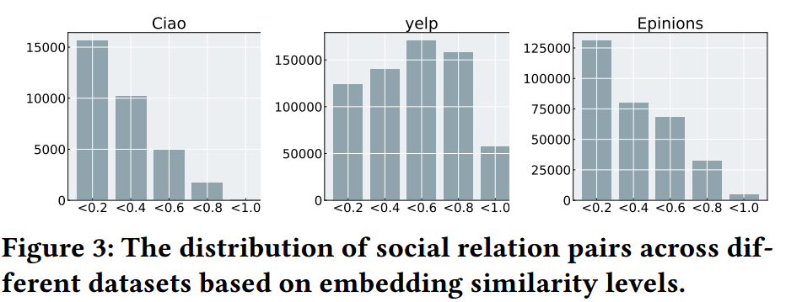
ATAI
AdvancedTechniqueof
Artificial Intelligence
ATAI
ChongqingUniversity _{AdvancedTechniqueof}
of Technology Artificial Intelligence
ChongqingUniversity of Technology
Experiments

Slide 11
ATAI
AdvancedTechniqueof
Artificial Intelligence
ATAI
ChongqingUniversity _{AdvancedTechniqueof}
of Technology Artificial Intelligence
ChongqingUniversity of Technology
Experiments

Slide 12
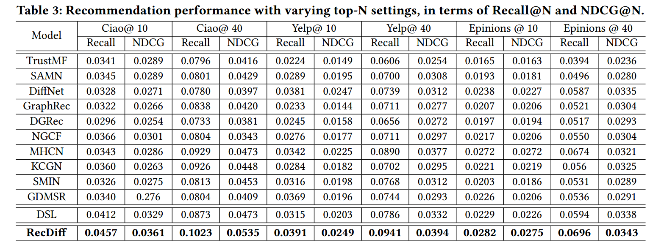
ATAI
AdvancedTechniqueof
Artificial Intelligence
ATAI
ChongqingUniversity _{AdvancedTechniqueof}
of Technology Artificial Intelligence
ChongqingUniversity of Technology
Experiments

Slide 13
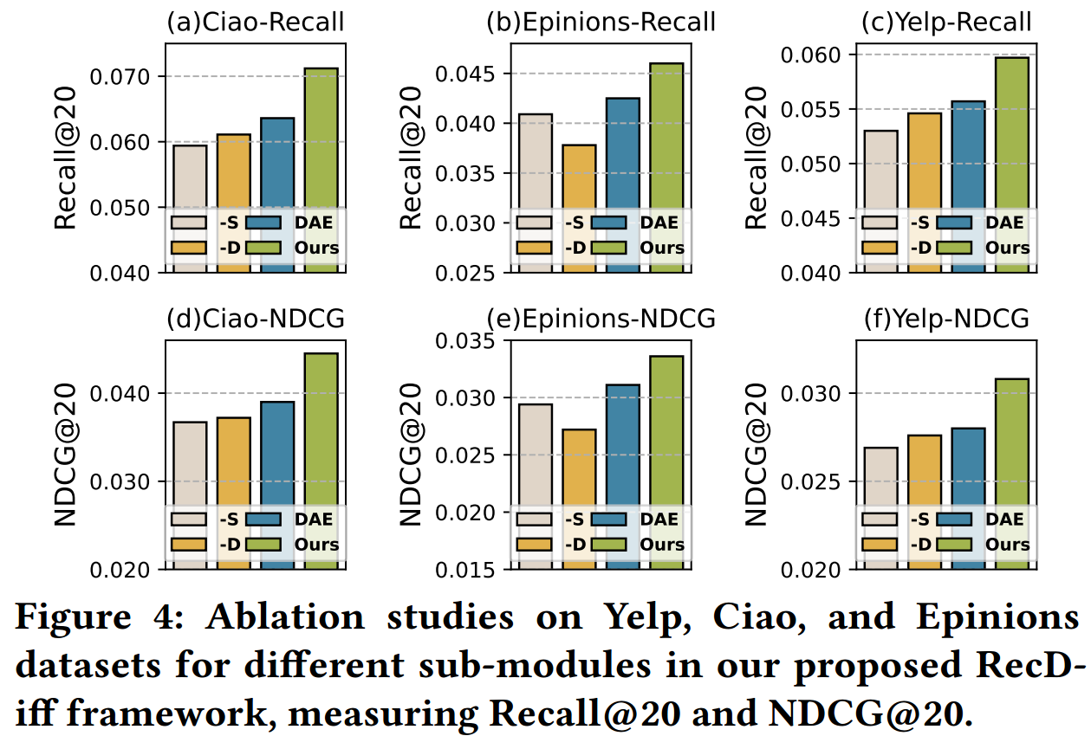
ATAI
AdvancedTechniqueof
Artificial Intelligence
ATAI
ChongqingUniversity _{AdvancedTechniqueof}
of Technology Artificial Intelligence
ChongqingUniversity of Technology
Experiments

Slide 14
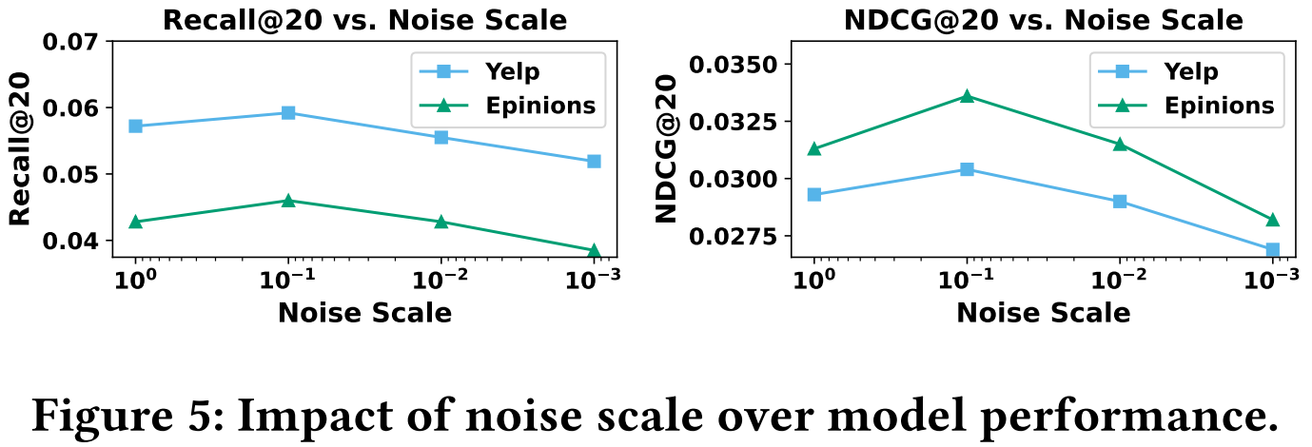
ATAI
AdvancedTechniqueof
Artificial Intelligence
ATAI
ChongqingUniversity _{AdvancedTechniqueof}
of Technology Artificial Intelligence
ChongqingUniversity of Technology
Experiments

Slide 15
ATAI
AdvancedTechniqueof
Artificial Intelligence
ATAI
ChongqingUniversity _{AdvancedTechniqueof}
of Technology Artificial Intelligence
ChongqingUniversity of Technology
Experiments

Slide 16
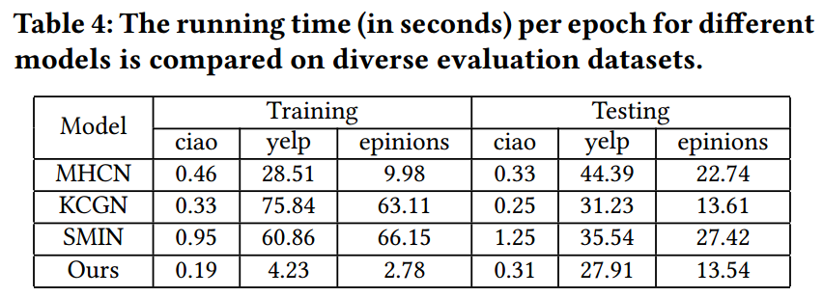
ATAI
AdvancedTechniqueof
Artificial Intelligence
ATAI
ChongqingUniversity _{AdvancedTechniqueof}
of Technology Artificial Intelligence
ChongqingUniversity of Technology
Experiments

Slide 17
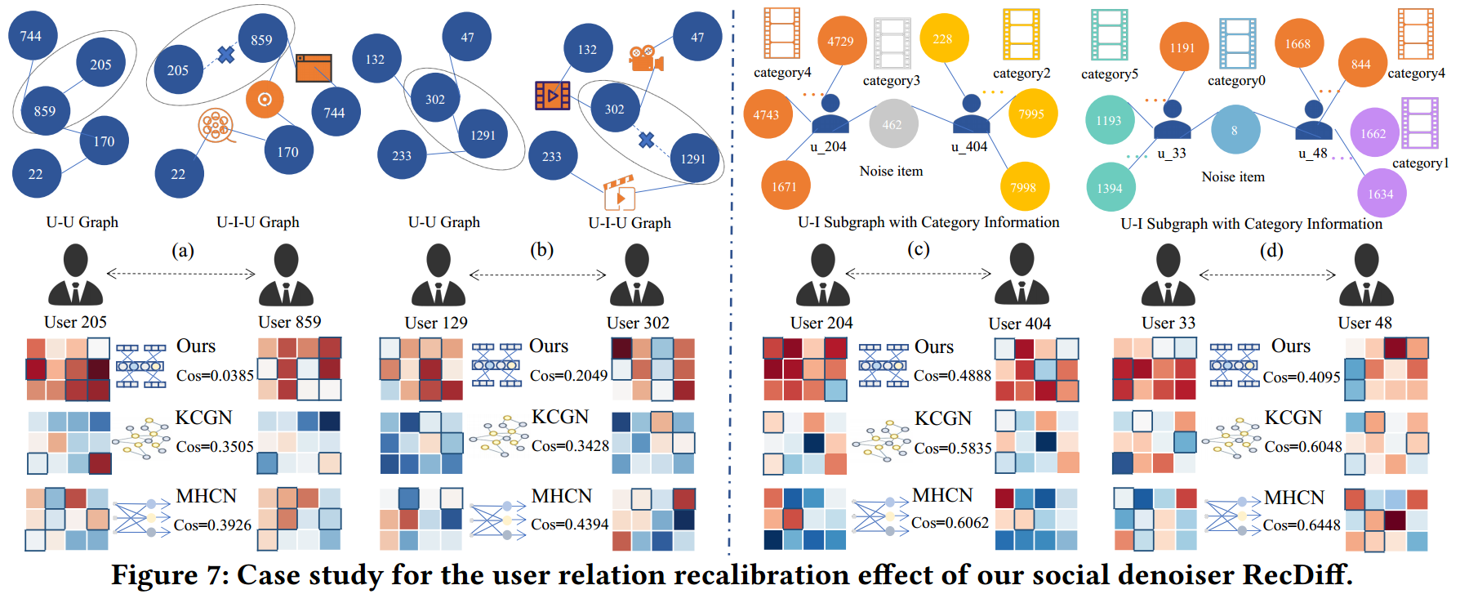
ATAI
AdvancedTechniqueof
Artificial Intelligence
ATAI
ChongqingUniversity _{AdvancedTechniqueof}
of Technology Artificial Intelligence
ChongqingUniversity of Technology
Experiments

Slide 18
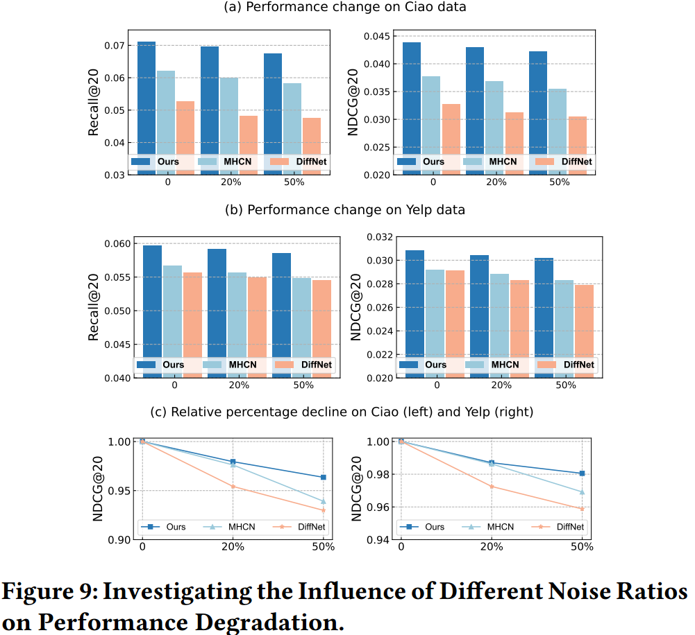
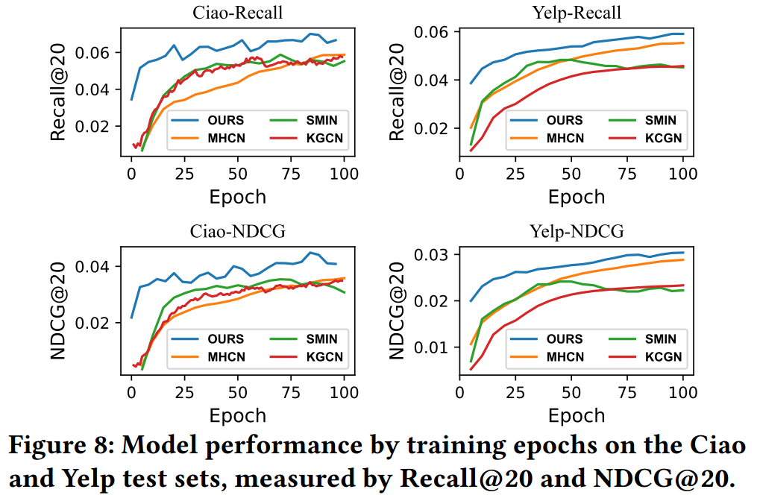
ATAI
AdvancedTechniqueof
Artificial Intelligence
ATAI
ChongqingUniversity _{AdvancedTechniqueof}
of Technology Artificial Intelligence
ChongqingUniversity of Technology
Experiments

Slide 19
ChongqingUniversity of Technology
ATAI
AdvancedTechniqueof
Artificial Intelligence
ATAI
ChongqingUniversity _{AdvancedTechniqueof}
of Technology Artificial Intelligence
Thanks!

